Slide 1
CIEEE Meeting Report
Hardware Part

Slide 2
AC Power Measurement IC
The IC chosen is Maxim Integrated 78M6613
DESCRIPTION
The Teridian™ 78M6613 is a highly integrated IC for
simplified implementation of single-phase AC power
measurement into power supplies, smart appliances, and
other applications with embedded AC load monitoring and control.

Slide 3
Features:
• < 0.5% Wh Accuracy Over Wide 2000:1
Current Range and Over Temperature
• Voltage Reference < 40ppm/°C
• Four Sensor Inputs—V3P3A Referenced
• 22-Bit Delta-Sigma ADC with Independent
32-Bit Compute Engine (CE)
• 8-Bit MPU (80515), One Clock Cycle per
Instruction with 2KB MPU XRAM
• 32KB Flash with Security
• Integrated In-Circuit Emulator (ICE) Interface
for MPU Debug

Slide 4
Features:
True RMS Calculations for Current,
Voltage, Line Frequency, Real Power,
Reactive Power, Apparent Power, and
Power Factor
o Accumulated Watt-Hours, Kilowatt-Hours
o Intelligent Switch Control at Zero
Crossings
o Digital Temperature Compensation
o Phase Compensation (±15°)
o Quick Calibration Routines
o 46–64Hz Line Frequency Range with
Same Calibration

Slide 5
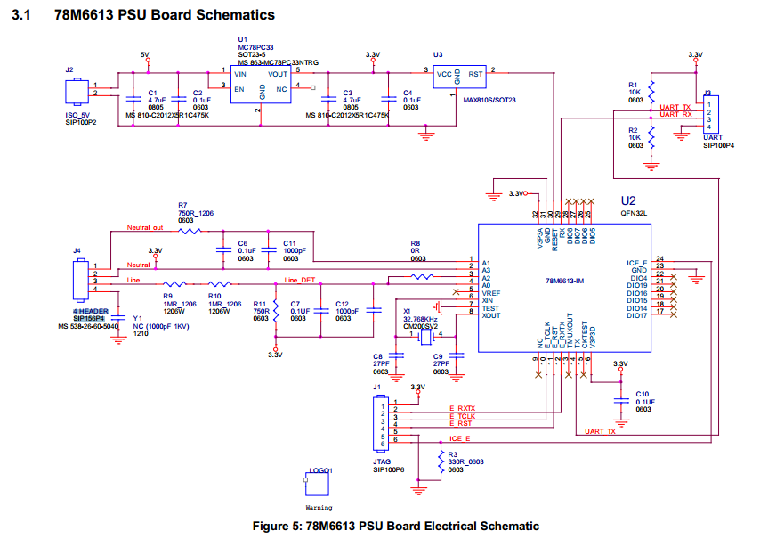

Slide 6
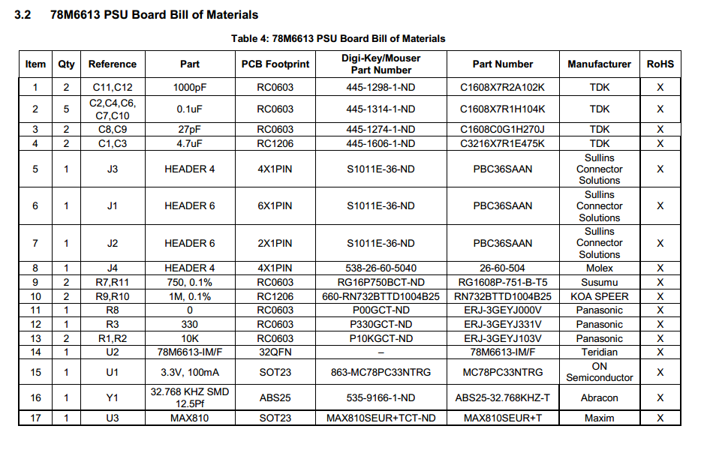

Slide 7
